Slide 1
Number, Arithmetic Operations, and Characters

Slide 2
Signed Integer
3 major representations:
Sign and magnitude
One’s complement
Two’s complement
Assumptions:
4-bit machine word
16 different values can be represented
Roughly half are positive, half are negative

Slide 3
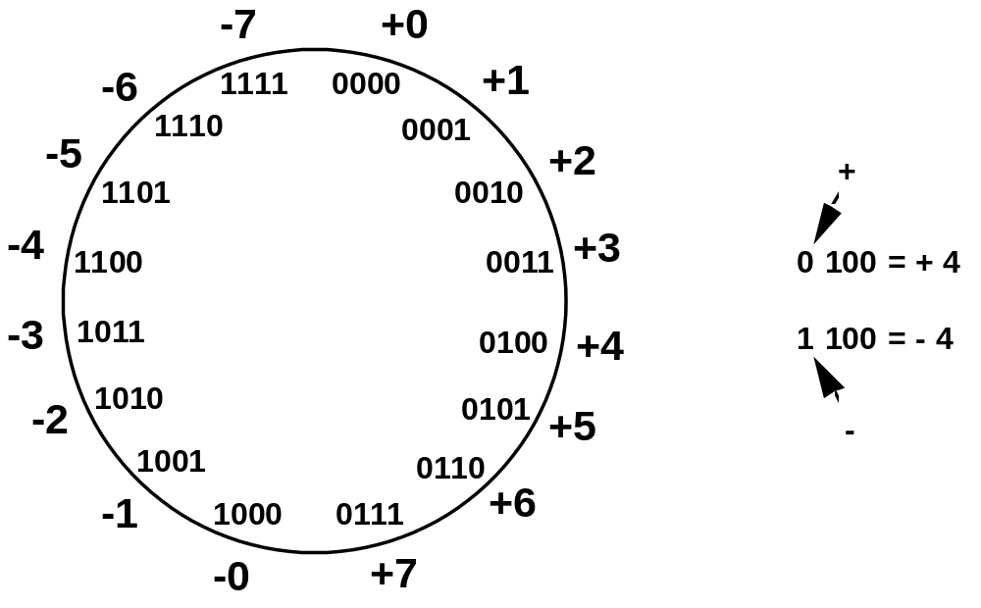
Sign and Magnitude Representation
High order bit is sign: 0 = positive (or zero), 1 = negative
Three low order bits is the magnitude: 0 (000) thru 7 (111)
Number range for n bits = +/-2^{n-1} -1
Two representations for 0

Slide 4
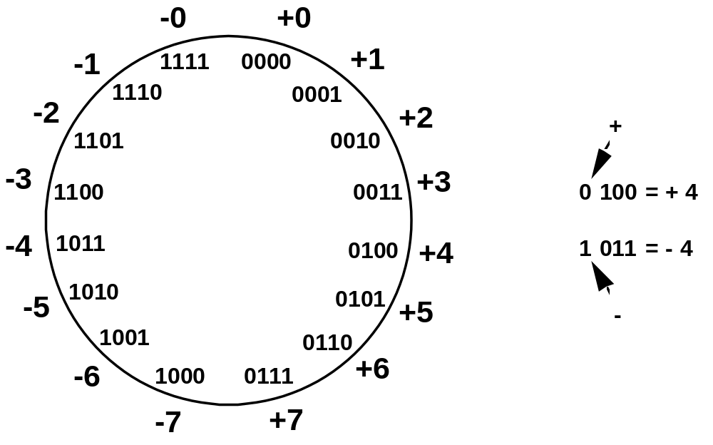
One’s Complement Representation
Subtraction implemented by addition & 1's complement
Still two representations of 0! This causes some problems
Some complexities in addition

Slide 5
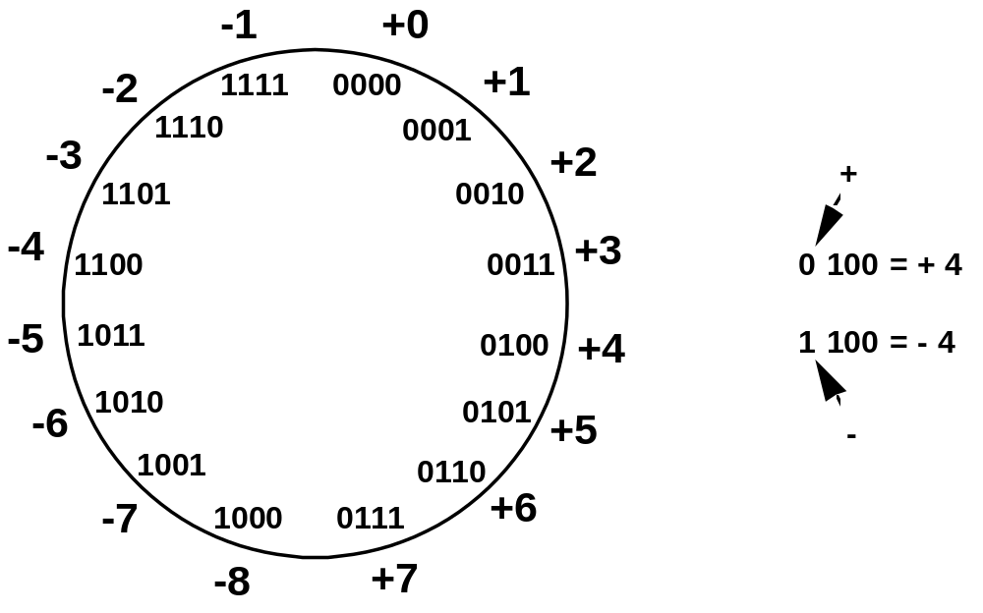
Two’s Complement Representation
like 1's comp
except shifted
one position
clockwise
Only one representation for 0
One more negative number than positive number

Slide 6
Binary, Signed-Integer Representations
B
V
alues represented
Sign and
b
3
b
2
b
1
b
0
magnitude
1'
s complement
2'
s complement
0
1
1
1
+
7
+
7
+
7
0
1
1
0
+
6
+
6
+
6
0
1
0
1
+
5
+
5
+
5
0
1
0
0
+
4
+
4
+
4
0
0
1
1
+
3
+
3
+
3
0
0
1
0
+
2
+
2
+
2
0
0
0
1
+
1
+
1
+
1
0
0
0
0
+
0
+
0
+
0
1
0
0
0
-
0
-
7
-
8
1
0
0
1
-
1
-
6
-
7
1
0
1
0
-
2
-
5
-
6
1
0
1
1
-
3
-
4
-
5
1
1
0
0
-
4
-
3
-
4
1
1
0
1
-
5
-
2
-
3
1
1
1
0
-
6
-
1
-
2
1
1
1
1
-
7
-
0
-
1
Figure 2.1. Binary, signed-integer representations.

Slide 7
Addition and Subtraction – 2’s Complement
4
+ 3
7
0100
0011
0111
-4
+ (-3)
-7
1100
1101
11001
If carry-in to the high
order bit =
carry-out then ignore
carry
if carry-in differs from
carry-out then overflow
4
- 3
1
0100
1101
10001
-4
+ 3
-1
1100
0011
1111
Simpler addition scheme makes twos complement the most common
choice for integer number systems within digital systems

Slide 8
2’s-Complement Add and Subtract Operations
(a)
0 0 1 0
(
+
2
)
(b)
0 1 0 0
(
+
4
)
+
0 0 1 1
(
+
3
)
+
1 0 1 0
(
-
6
)
0 1 0 1
(
+
5
)
1 1 1 0
(
-
2
)
(c)
1 0 1 1
(
-
5
)
(d)
0 1 1 1
(
+
7
)
+
1 1 1 0
(
-
2
)
+
1 1 0 1
(
-
3
)
1 0 0 1
(
-
7
)
0 1 0 0
(
+
4
)
(e)
1 1 0 1
(
-
3
)
1 1 0 1
-
1 0 0 1
(
-
7
)
+
0 1 1 1
0 1 0 0
(
+
4
)
(f)
0 0 1 0
(
+
2
)
0 0 1 0
-
0 1 0 0
(
+
4
)
+
1 1 0 0
1 1 1 0
(
-
2
)
(g)
0 1 1 0
(
+
6
)
0 1 1 0
-
0 0 1 1
(
+
3
)
+
1 1 0 1
0 0 1 1
(
+
3
)
(h)
1 0 0 1
(
-
7
)
1 0 0 1
-
1 0 1 1
(
-
5
)
+
0 1 0 1
1 1 1 0
(
-
2
)
(i)
1 0 0 1
(
-
7
)
1 0 0 1
-
0 0 0 1
(
+
1
)
+
1 1 1 1
1 0 0 0
(
-
8
)
(j)
0 0 1 0
(
+
2
)
0 0 1 0
-
1 1 0 1
(
-
3
)
+
0 0 1 1
0 1 0 1
(
+
5
)
Figure 2.4. 2's-complement Add and Subtract operations.

Slide 9
Overflow - Add two positive numbers to get a negative number or two negative numbers to get a positive number
-1
+0
-1
+0
-2
1111
0000
+1
-2
1111
0000
+1
-3
1110
0001
-3
1110
0001
1101
+2
1101
+2
-4
0010
-4
0010
1100
0011
+3
1100
0011
+3
-5
1011
-5
0100
+4
1011
0100
+4
-6
1010
-6
1010
0101
+5
0101
+5
1001
0110
1001
0110
-7
1000
+6
-7
+6
0111
1000
0111
-8
+7
-8
+7
5 + 3 = -8
-7 - 2 = +7

Slide 10
Overflow Conditions
0 1 1 1
0 1 0 1
0 0 1 1
1 0 0 0
1 0 0 0
1 0 0 1
1 1 0 0
1 0 1 1 1
5
3
-8
-7
-2
7
Overflow
Overflow
0 0 0 0
0 1 0 1
0 0 1 0
0 1 1 1
1 1 1 1
1 1 0 1
1 0 1 1
1 1 0 0 0
5
2
7
-3
-5
-8
No overflow
No overflow
Overflow when carry-in to the high-order bit does not equal carry out

Slide 11
Sign Extension
Task:
  Given w-bit signed integer x
  Convert it to w+k-bit integer with same value
Rule:
  Make k copies of sign bit:
  X ′ = x_{w–1} ,…, x_{w–1} , x_{w–1} , x_{w–2} ,…, x₀
w
X
• • •
k copies of MSB
• • •
X ′
• • •
• • •
k
w

Slide 12
Characters
Computer mut be able to handle nonnumeric text information consisting of characters.
Characters can be letters of the alphabet, decimal digits, punctuation marks, and so on. They are represented by codes that are usually 7-bits or 8-bits long. One of the most widely used such codes is ASCII.

Slide 13
Problems
Q1. Find the equivalent number for given number of bits, if it is in 1’s complement represent system.
011
111
101
010
110

Slide 14
Problems
Q2. Find the equivalent number for given number of bits, if it is in 2’s complement represent system.
011
111
101
010
110

Slide 15
Thanks

